Slide 1

JavaScript Objects
Aruna S
Department of
Computer Science and Engineering

Slide 2

JAVASCRIPT OBJECTS
Prototype Inheritance
S. Aruna
Department of Computer Science and Engineering

Slide 3
JAVASCRIPT OBJECTS
Prototype Property - Accessing Properties and Methods
JavaScript is a prototype based language-object properties and methods can be shared through generalized objects that have the ability to be cloned and extended.
All objects in JavaScript descend from the parent Object constructor.
Every object in JavaScript has an internal property called [[Prototype]]
Built in objects also has Prototype property
Adding new properties and methods to the prototype property is better compared to adding directly to the constructor.

Slide 4
JAVASCRIPT OBJECTS
Prototype Property
All objects in JavaScript inherit from at least one other object.
The object being inherited from is known as the prototype, and the inherited properties can be found in the prototype object of the constructor.
Access properties and methods outside the objects
Search on Object
Search on object’s [[Prototype]]
[[Prototype]] of Linked Object
Null
Search continues to all Linked objects

Slide 5
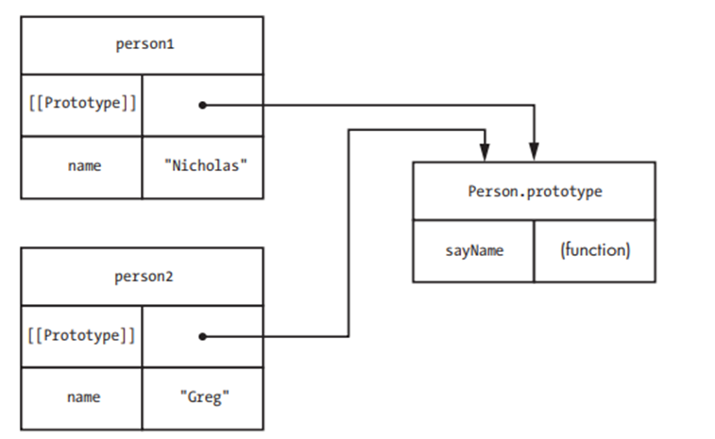
JAVASCRIPT OBJECTS
Prototype Properties

Slide 6
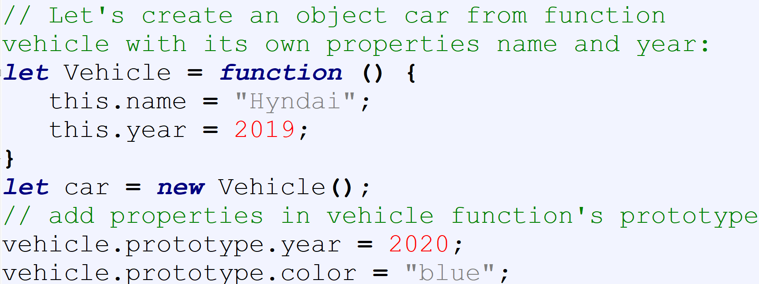
JAVASCRIPT OBJECTS
Prototype Chain
car.[[Prototype]] = {year,color}
car.[[Prototype]].[[Prototype]] => Object.prototype
car.[[Prototype]].[[Prototype]].[[Prototype]] =>null

Slide 7
JAVASCRIPT OBJECTS
Prototype Chain - Questions
console.log(car.name)?
console.log(car.year)? Prototype Shadowing happens here
console.log(car.color)?
console.log(car.model)?

Slide 8
JAVASCRIPT OBJECTS
Object.create() method
Object.create() method is used to create a new object with the specified prototype object and properties.
Returns a new object with the specified prototype object.
Used for implementing inheritance.
Object.create(prototype_object, propertiesObject)
prototypeObject: Newly created object’s prototype object. It has to be an object or null.
propertiesObject: Properties of the new object. (Data Descriptors and Access Descriptors)

Slide 9
JAVASCRIPT OBJECTS
Practice Exercise
Exercise

Slide 10
THANK YOU
Aruna S
Department of
Computer Science and Engineering
arunas@pes.edu

